Slide 1
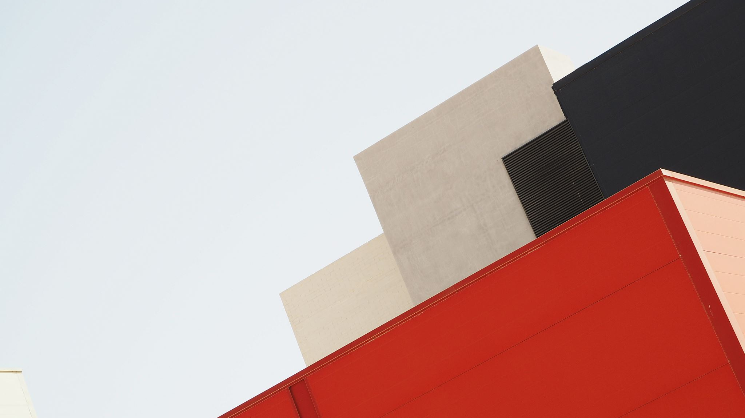
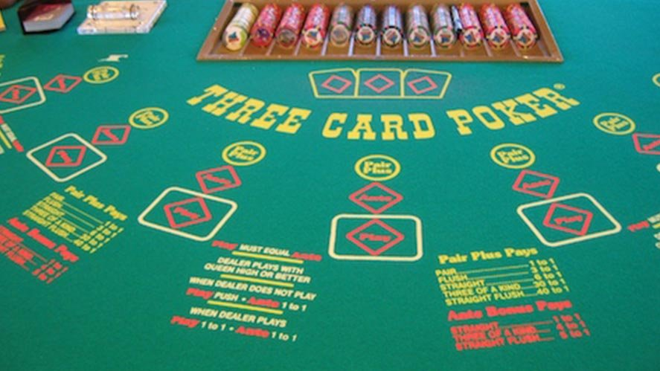

Group 23: Three Card poker
https://tunicatravel.com/blog/2015/07/best-ante-bet-strategy-in-three-card-poker/
LUKE, CONNOR, CAM, and Kiarash

Slide 2
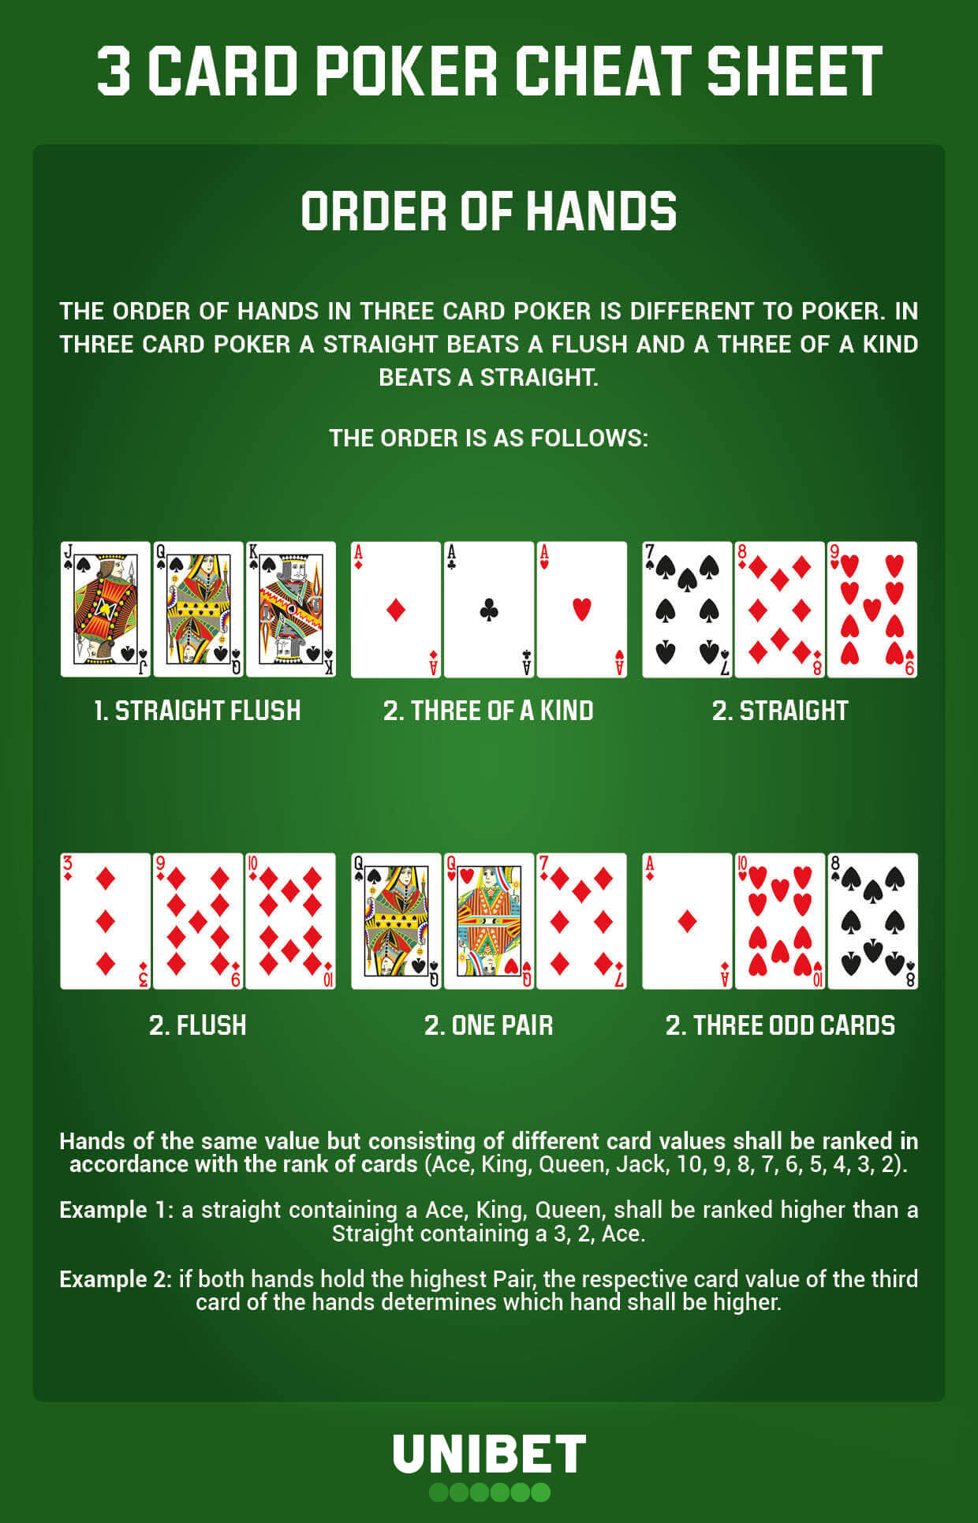
Summary
Our project strives to model the popular and fun game three card poker. The model determines which hand wins the round.
The model also provides suggestions on if the player should double down, play the hand, or fold based according to their hand.
The model also determines how much the user wins or loses each round based on a standard poker betting system.
https://www.unibet.co.uk/livecasino/guides/how-to-play-3-card-poker-1.781145

Slide 3

Rules of the game
The user must opt into the round by placing their bet
3 cards are dealt to the user face up and 3 cards are dealt to the dealer face down
The user then makes a decision to play the hand, fold, or double down
The dealer's hand are revealed and the player with the better hand wins the round and the pot
The order of the hand rankings is straight flush, three of a kind, straight, flush, one pair, three odd cards
If the hands are equal, then the user is returned their original bet

Slide 4
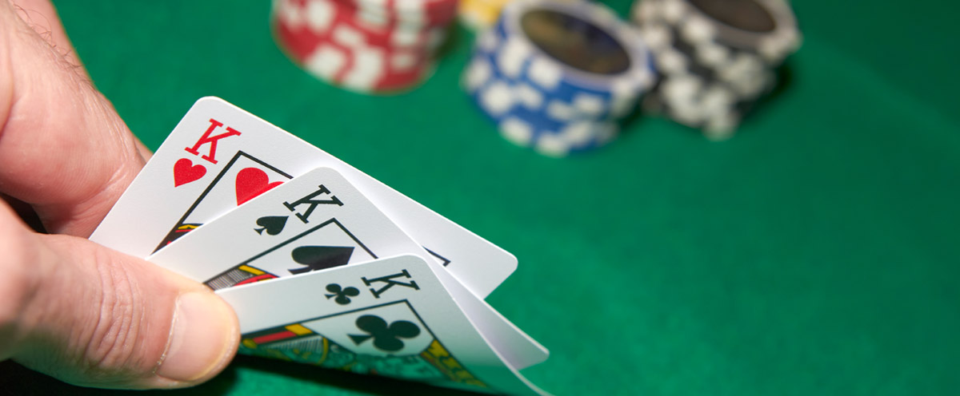
Propositions
https://www.thebike.com/play/california_game_three_card_poker.php
Hand: Let x1, x2, x3, be the three cards in the user's hand
N1 is true if x1 is an ace, N2 is true if x1 is a 2, …., N11 is true if x1 is a jack, N12 is true if x2 is a queen, N13 is true if x1 is a king
SS is true if x1’s suit is a spade, SC is true if x1 is a club, SD is true if x1 is a diamond, and SH is true if x1 is a heart
Similarly, let y1, y2, y3 be the three cards in the dealer's hand, which follow the same Numbering and Suit principal as the user's hand.
Hand Rankings: SF is true if the hand is a straight flush, T is true if the hand is a three of a kind, S is true if the hand is a straight, F is true if the hand has a flush, P is true if the hand has a pair, H is true if the hand is a high card
Would also need to know if two players have a high card hand, who's hand is higher, etc.
Betting: FOLD is true if user should fold, PLAY is true if user should play, DOUBLE is true if user should double down
For example, if the user has at least a queen as their highest card, at least a 6 as their second highest card, and at least a 4 as their third highest card then they should play the hand
Win/Lose: W is true if user wins the hand, ~W if user loses the hand
We will also need to determine winnings (ex. double if double down)

Slide 5
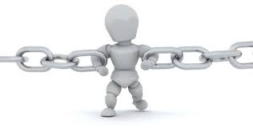
Constraints
https://planningengineer.net/when-you-can-use-constraints-in-primavera-p6-time-schedule/
Hand Constraints: Each hand must consist of exactly three cards, the rank of the hand is determined by standard three card poker hand rankings (Ex. N1(x1)_{U} ∧ N1(x2)_{U} ∧ ~N1(x3)_{U} → P demonstrates that the user has a pair of aces) *Note: Subscript u means user
REMINDER: No duplicate cards within the dealers three cards and the users three cards (ex. Only one King of Spades)
Ensure that all cards are valid card in a standard 52 card deck
A hand is only valid if it has exactly three cards: HAND_{U} ↔ (x1 ∧ x2 ∧ x3)
Betting Constraints: Players must decide whether they want to fold the hand, play the hand, or double down after they have received all three cards. The game also requires constraints on maximum and minimum betting amounts
The player can not bet more than the amount they have in their hand. They also must place at least the minimum bet and less than the maximum bet
Let V be a valid Bet. ~V is an invalid bet. A = amount in users' hand, x is the bet amount, 5<=x<=1000 ∧ x<=A → V
Winning Constraints: The player with the highest ranking hand wins, if the hands have equal value, then the dealer wins the tie
Ex. (SF(x1, x2, x3) ∧ ~SF(y1, y2, y3)) ∨ (T(x1, x2, x3) ∧ ~T(y1, y2, y3)) ∨ (S(x1, x2, x3) ∧ ~S(y1, y2, y3)) ∨ (F(x1, x2, x3) ∧ ~F(y1, y2, y3)) ∨ (P(x1, x2, x3) ∧ ~P(y1, y2, y3)) ∨ (H(x1, x2, x3) ∧ ~H(y1, y2, y3)) → W_{U}

Slide 6
End

